Slide 1

GIST Workflow
“Collection development as we know it will cease to exist as selection of library materials will be entirely patron-initiated…”
http://www.taigaforum.org/documents/Taiga%204%20Statements%20After.pdf
Notes:
Do we agree with this projection?

Slide 2
Getting It System Toolkit (GIST)
GIST Team (SUNY Geneseo)
Tim Bowersox, GIST Web Interface and ILLiad Workflow Designer
Cyril Oberlander, Project Consultant
Kate Pitcher, GIST Acquisition and Collection Development Designer
Ed Rivenburgh, Project Sponsor
Mark Sullivan, Project Manager & Geneseo Programmer
GIST Grant Funding
Rochester Regional Library Council – Regional Bibliographic Databases & Interlibrary Resources Sharing Grant
Worldcat API Programming Consultants
Kyle Banerjee, Digital Services Program Manager at the Orbis Cascade Alliance
Terry Reese, Oregon State University

Slide 3
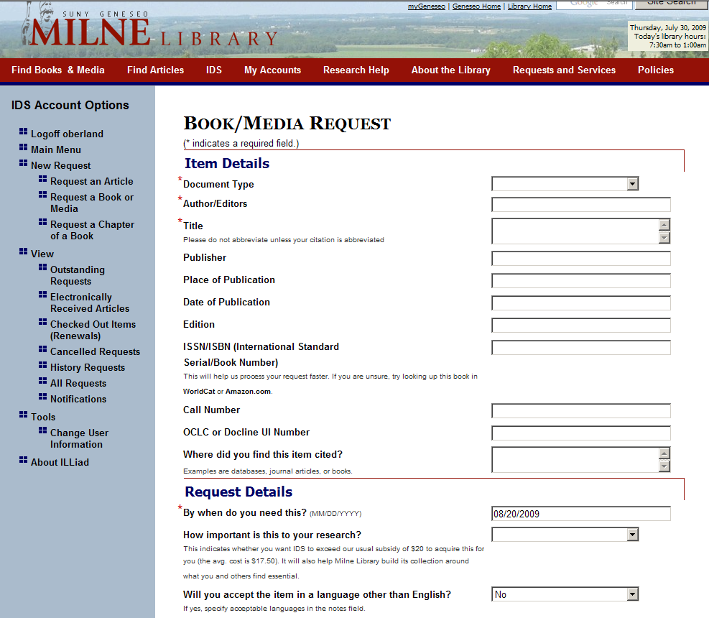
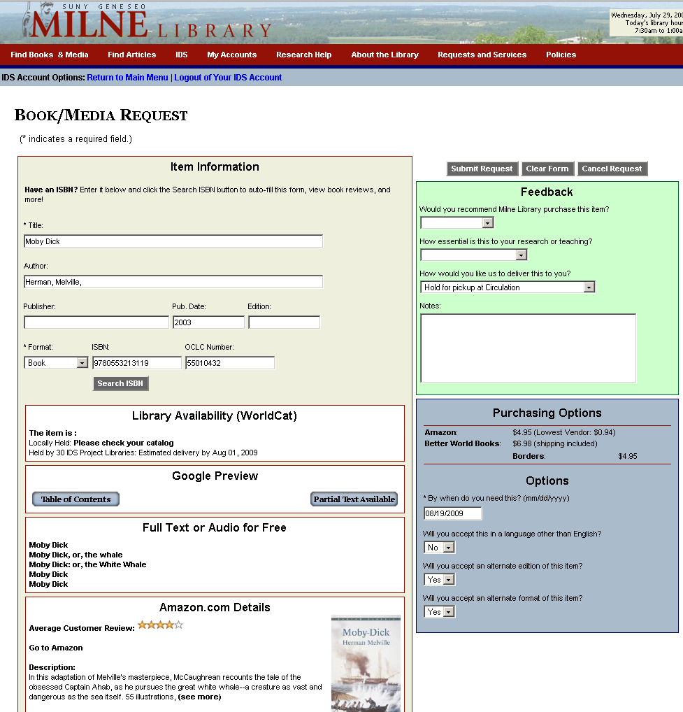
Developing the GIST Interface
ILLiad Loan Form
ILLiad GIST Form
Notes:
GIST Interface uses ILLiad’s request form, which can be a standalone form, a customized form specific to certain statuses, for example, only librarians, or faculty can see the GIST form, or a variety of GIST elements can be incorporated differently on various forms. GIST is written in .NET framework, so that it can be loaded onto ILLiad libraries that are hosted by OCLC.

Slide 4
GIST Request Form
Notes:
Basic view of the GIST Form, important to know that the components that pull in data from other services, i.e. Worldcat, Google, Amazon, etc., will not be shown if no data is matched during the request process, and in the configuration file, it is easy to turn a component on or off, or customize it.

Slide 5
Data Services using various APIs
ILLiad Request Form
Custom, Standalone, OpenURL, Status Specific
Purchasing Options
Amazon API link price of New & Lowest Price – user may want to purchase from this link.
ILL & Acquisition Staff see the New & Lowest Price in requests.
Better World Books, Google APIs are also currently used, we have asked other vendors for APIs.
Worldcat API
User sees if owned locally, click to catalog, and estimated turnaround time.
Staff see if held locally, and # holdings in 2 configurable groups
Google Books
User sees Table of Contents, No-Partial, & Full Text Views.
Staff see if full text in Google GOOGL
Index Data
User sees if full text version in OCA, Internet Archive, & more.
Staff see if full text INARC
Amazon API
Reviews, Ranking, and quick link to Amazon. Price was moved into Purchasing Options window.

Slide 6
ILL & GIST API Components
Purchasing Options
User sees price to purchase from Amazon API with New & Lowest Price listed (used) – user may want to purchase from this link. If they do, Amazon provides our AWS account a credit for referring someone to purchase.
ILL & Acquisition Staff see the New & Lowest Price in the ILLiad requests.
Better World Books, Google APIs are also currently used for pricing, we have asked other vendors for APIs.
Worldcat API – Library Availability
User sees if owned locally, easy click to catalog, and sees estimated turnaround time.
ILL & Acquisitions staff see if held locally, and # holdings in 2 configurable groups (consortia, state, etc.)
Google Books
User sees Table of Contents, No-Partial, & Full Text Views.
Staff see if full text in Google (GOOGL)
Amazon API
Enhances users request evaluation with Reviews, Ranking, Cover, and quick link to Amazon.
Price was moved into Purchasing Options window.
Index Data
User sees if full text or audio version in OCA, Internet Archive, etc.
Staff see if full text OCA (INARC)
Notes:
There are 5 API components in the GIST interface; Worldcat API, Google Books, Index Data, Amazon, and purchasing options. By default, they are activated, however, the library can simply turn off any component they do not want to see, and how the data from each component is highly configurable for end-user, as well as, staff within the ILLiad request. Also important is that each component has a switch – if no values are returned, the window is not displayed, and if the data takes time to retrieve, a status bar appears.
Worldcat API – SUNY Geneseo contracted Terry Reese, Oregon State University and Kyle Bannerjee, Summit to develop the Worldcat API for GIST. Mark Sullivan configured it to work with ILLiad. The purpose of the Worldcat API component is to bring back holdings information to the user – if held locally, it says so and the Please check your catalog is a one click into a search of your catalog using the OCLC#. Especially helpful considering about 10-15% of ILL requests are for materials owned by the local library. The availability in IDS Project libraries and estimated delivery time is a configurable set of two groups – you might want one for your resource sharing consortia (of which turnaround times might be consistent), and the other is your state. While the user might only want to know when they might expect it, Acquisitions staff no longer have to look up holdings in their preferred cooperative collection groups to determine how widely these are held before making a decision to cancel. In fact, not only is the decision easier, the cancel email from ILLiad incorporates those numbers automatically into the emails.
Google Books API enhances the user’s evaluation of the material they are requesting with additional data, such as Table of Contents or Partial Text Available, however, the user may also discover that the item they need is Full Text Available. Both ILL and Acquisitions staff see GOOGL (Google’s OCLC symbol) when a requested item is available full text, and at Geneseo, a routing rule automatically places the request in a specific queue – the staff will send the user an email using ILLiad that has the Google Book URL, and copies the electronic resources librarian to please catalog the resource.
Similarly with Index Data API, a combined search of various free full text and audio sources from Open Content Alliance, Internet Archive, Gutenberg, etc. is performed and results may interest the user. The staff see INARC (Internet Archives OCLC Symbol) when a requested item is available from the Index Data sources, and again, a routing rule places that request in a specific queue for staff.
Amazons API was initially designed by Portland State University as the Price Grabber, but Mark Sullivan remade that program in .NET to be the Amazon Price Reviewer and more. This enables users more evaluation data to help their request decision making process. It also provides data for the purchasing options.
Purchasing Options is a combination of API data from Amazon, Better World Books, and Google Books. This service enables users to see price data, and click through to buy. If they buy from Amazon or Better World Books, our accounts are given credit for referring buyers. What the ILL and Acquisitions staff see in the ILLiad request is Amazon’s new and lowest cost to buy the item – which for ILL helps them determine if buying is less expensive than borrowing – there are a lot of libraries out there that charge $20 / request. For Acquisitions staff, the purchasing data eliminates the need for searching various prices. We have asked many of the book jobbers and dealers for APIs, so as we hear back from them, we plan to incorporate more, and enable easy configuration so that a library with preferred or specific vendors can activate only those purchasing APIs.
Last point we want to emphasize is that all this is very flexible, where it appears, how it looks to user and staff, so we see this as really the first template of many, as libraries adapt this, as they customize views to specific user status; faculty, student, administrator, etc.

Slide 7
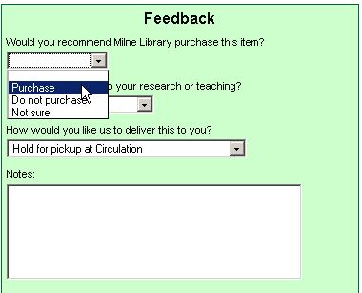
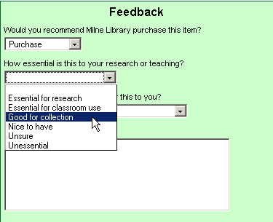
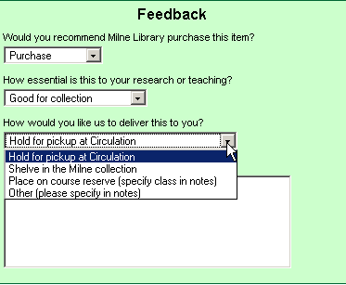
GIST Feedback

Slide 8
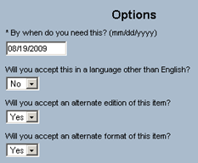
GIST ILLiad Options
Will you accept an alternative format of this item?

Slide 9
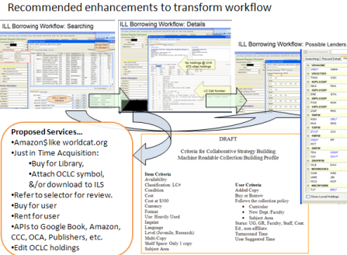
GIST is customizable
You choose and adapt the tool around what works for your setting.
Library A
Library B
Library C
Library D
GIST tools used to enhance ILL Purchase on Demand only.
GIST used by Librarians.
GIST also used only by Librarians to help their selection.
GIST used selectively.
GIST also used by Faculty, with Librarian Review.
GIST default with collection building parameters.
GIST used by all users, with some Librarian review for certain status. Collection building profiles, cooperative data, and gift management features used.
Notes:
Because GIST tools are customizable components, and libraries do love doing things there own way, we would expect to see a diversity of adaptation based on local practices and politics.
illustrate

Slide 10

ILL & GIST Workflow
GIST Request
Interlibrary Loan / IDS
Cancel or
Unfilled
Filled
Borrow
Acquisitions
ILLiad CitedTitle = Purchase
Filled
Buy
Cancel or Borrow
Requests are Transferable
Notes:
GIST requests can be either an ILL or Acquisitions request. For Geneseo, if the user recommends the library purchase the work, then the request is automatically routed into an acquisitions queue in ILLiad’s Document Delivery Module. CLICK However, at any point in time, library staff can re-route the request into an ILL or from ILL to an Acquisitions request. For instance, if the cost to borrow something is higher than purchasing it, it can become an acquisitions request by simply clicking on ILLiad’s route to, and direct it into an acquisitions processing queue. Leveraging the strengths and flexibility of ILLiad is important not only in transferring requests between library services, it also helps to have parallel and empowering strategies. One is filling requests for materials that are available full text…

Slide 11
ILL & GIST Workflow
Cancelling Full Text Available
GIST Request
Interlibrary Loan / IDS
Cancel or
Unfilled
Filled
Borrow
Acquisitions
ILLiad CitedTitle = Purchase
Filled
Buy
Cancel or Borrow
Cancel Full Text =
Filled Document Delivery & Cataloging free e-books
Cancel Full Text = Filled Document Delivery & Cataloging free e-books

Slide 12
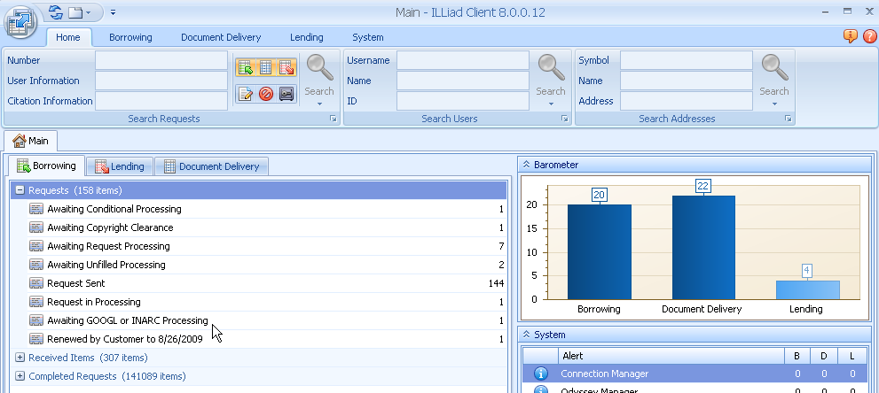
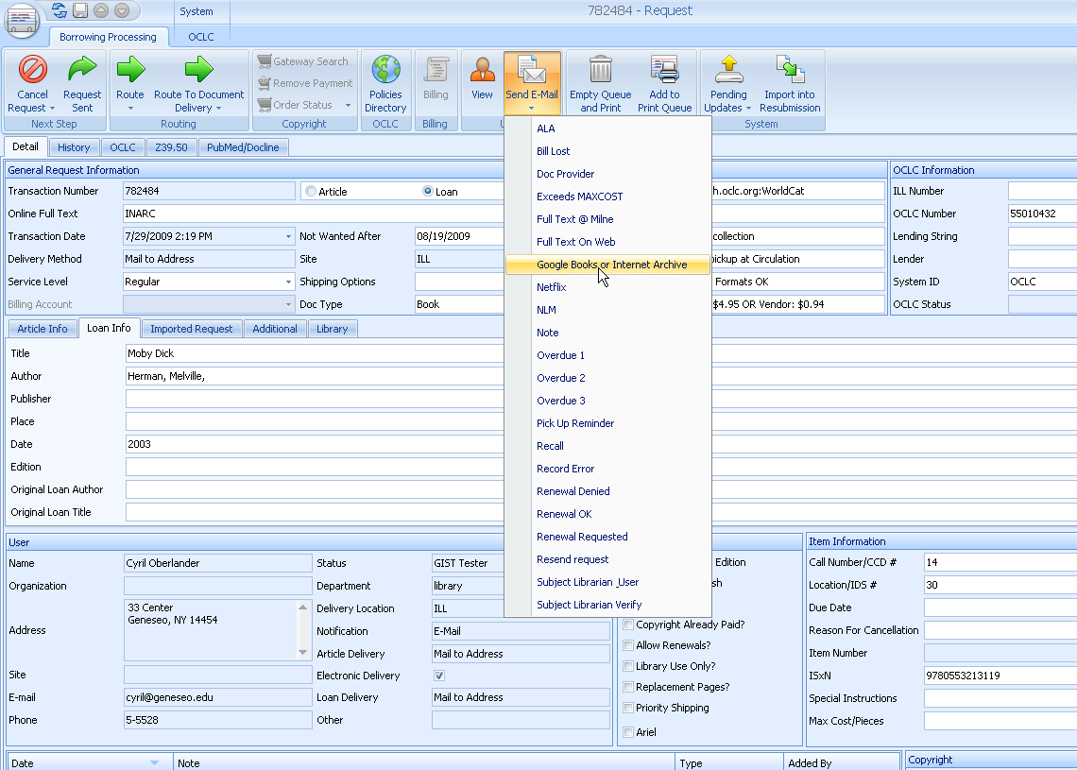
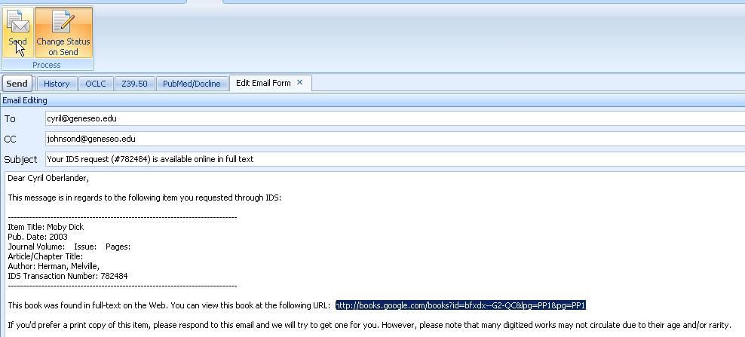
ILL & GIST Workflow
Cancelling Full Text Available
GIST Request
Interlibrary Loan / IDS
Cancel or
Unfilled
Filled
Borrow
Acquisitions
ILLiad CitedTitle = Purchase
Filled
Buy
Cancel or Borrow
Cancel Full Text =
Filled Document Delivery & Cataloging free e-books
Cancel Full Text = Filled Document Delivery & Cataloging free e-books
Notes:
If an ILL or purchase request is submitted for a work that is available from Google books or Index Data’s free sources, ILLiad automatically routes the request to Awaiting GOOGL and INARC Processing in Borrowing (One note, it can be Document Delivery if CitedTitle = Purchase – each library decides how process, policy and strategies are configured, mediated, etc.)
CLICK
When staff open the request details and find the free internet source, they simply use an ILLiad Email Routing to cancel/fill a full text request, sending the URL to the user, as well as to the electronic resources cataloger.
CLICK
This is the staff view of the ILLiad email just before it is sent. ILLiad’s email routing rule automatically places the request in the Request Finished queue.

Slide 13
ILL & GIST Workflow
GIST Request
Interlibrary Loan / IDS
Cancel or
Unfilled
Filled
Borrow
Acquisitions
ILLiad CitedTitle = Purchase
Filled
Buy
Cancel or Borrow
Notes:
Now let’s focus on the Acquisitions process in particular

Slide 14
ILL & GIST Workflow
Purchasing
Acquisitions
Awaiting Acquisitions Processing
Review Required
Review needed – request can be automatically routed in these queue because of department affiliation.
Email sent via ILLiad, request is routed to specific pending queues
Awaiting Librarian Approval
If approved, process as purchase request.
If not, cancel or borrow.
Processing Purchase Requests
User, department & budget validation.
Check holdings in GIST Item Information.
Copy ISBN – search in Amazon, etc. to place order.
Copy OCLC number to download record and attach holdings.
Email sent via ILLiad, request is routed to Purchase Request Ordered from Vendor
Purchase Request Ordered from Vendor
When item is received, Email sent via ILLiad, request is routed to Request Finished
Awaiting Faculty Rep
If approved, process as purchase request.
If not, cancel or borrow.
Request Finished
Item made available as per user preference; Hold for Pickup, Shelved in Library, Placed on Reserve
Notes:
Map Version 2

Slide 15
ILL & GIST Workflow
Cancelling Purchasing Options
Acquisitions
Awaiting Acquisitions Processing
Processing Purchase Requests
User, department & budget validation.
Check holdings in GIST Item Information.
Copy ISBN – search in Amazon, etc. to place order.
Copy OCLC number to download record and attach holdings.
Email sent via ILLiad, request is routed to Purchase Request Ordered from Vendor
Purchase Request Ordered from Vendor
When item is received, Email sent via ILLiad, request is routed to Request Finished
Duplicate Holdings
If title is owned by more than 3 Cooperative Collection Development libraries request routes automatically to Purchase Request Exceeds CCD limit. Cancel or Buy Collection Development Librarian decides.
If cancelled, Email sent via ILLiad, request is routed to Cancelled by ILL Staff.
Request Finished
Item made available as per user preference; Hold for Pickup, Shelved in Library, Placed on Reserve
Cancel Request
Cancel Due to Lack of Funds
Email sent via ILLiad, request is routed to Cancelled by ILL Staff, or User asks to Borrow.
Cancel – Held Locally
Email sent via ILLiad, email has LC# and location, request is routed to Cancelled by ILL Staff.
Notes:
Version 1

Slide 16
GIST Acquisitions Workflow Map
GIST Request
ILL Request Processing
Awaiting Acquisitions Processing
Cancel
Borrow
Available on Web
Cancel Request
Review Required
Processing Purchase Request
Catalog
Free Sources
Email sent:
Librarian or Faculty Rep
Purchase from Vendor
Notify User
Download record & attach symbol
NO
YES
Purchase Request Ordered from Vendor Queue
Receiving Request
Notify User
Preferred Delivery
Notes:
Version 3
Describe two workflows CLICK
Explain that whenever an ILL request costs more to borrow than buy, it can be routed into an acquisitions process, similarly, any cancellation of an acquisition request can easily be routed into an ILL request. CLICK
Requests that have materials Available on the Web or requests that require Review, are automatically routed to queues to help staff identify the process. CLICK
Some of the cancel requests are automatically routed to specific queues, for instance, when ever the acquisitions request is held locally or held by too many libraries, it lands in a designated queue.

Slide 17
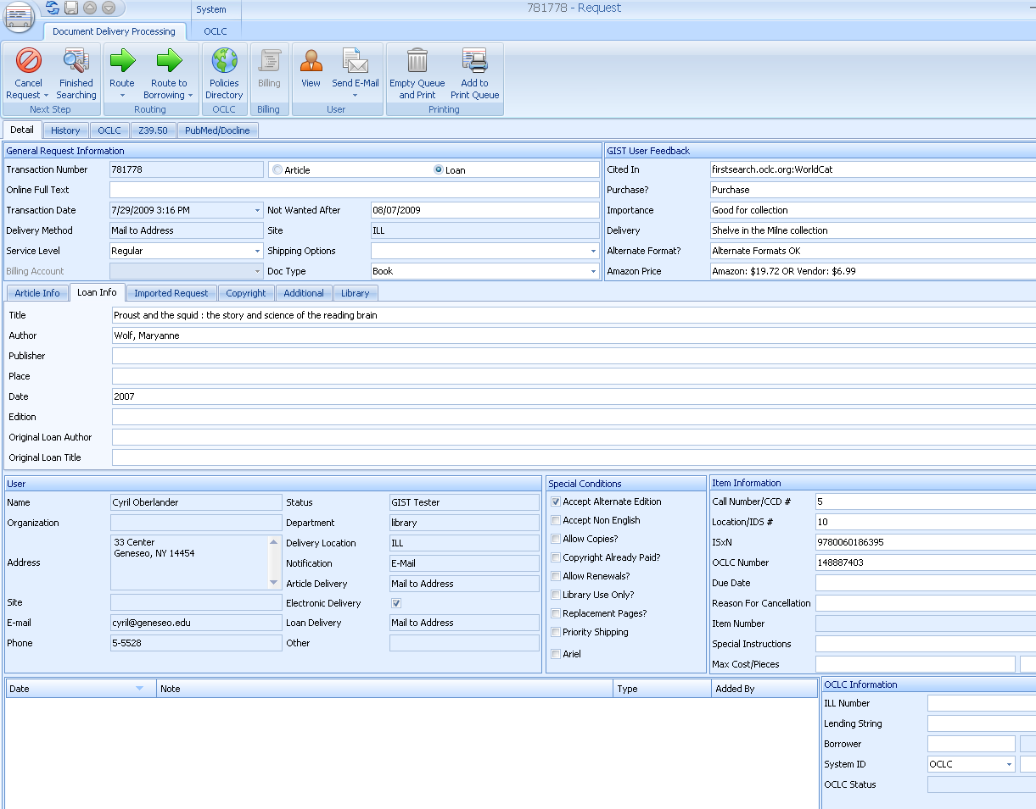
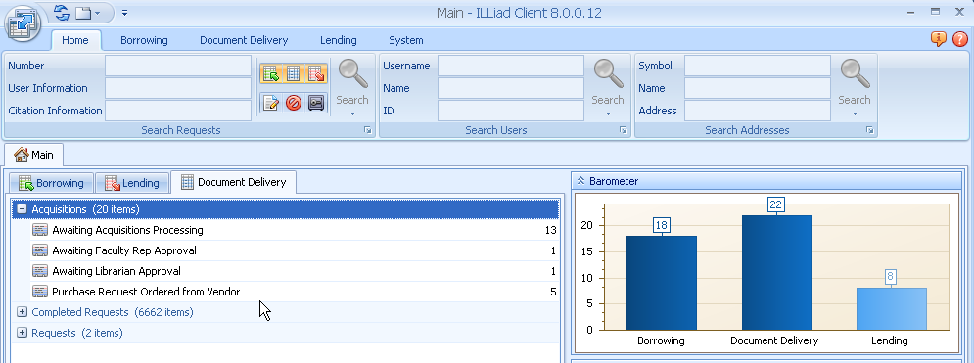
ILL & GIST Workflow Screenshots
Notes:
What it looks like for staff…

Slide 18
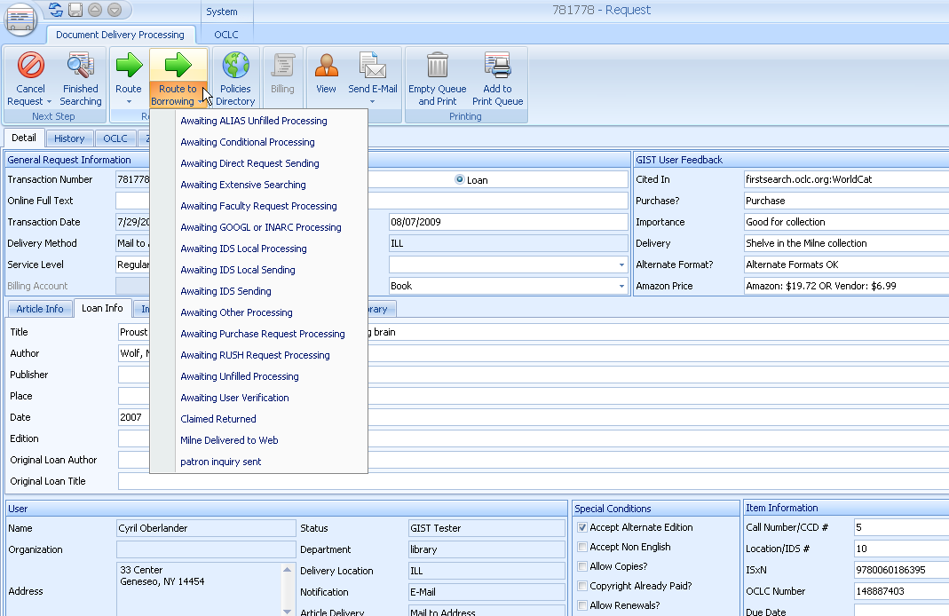
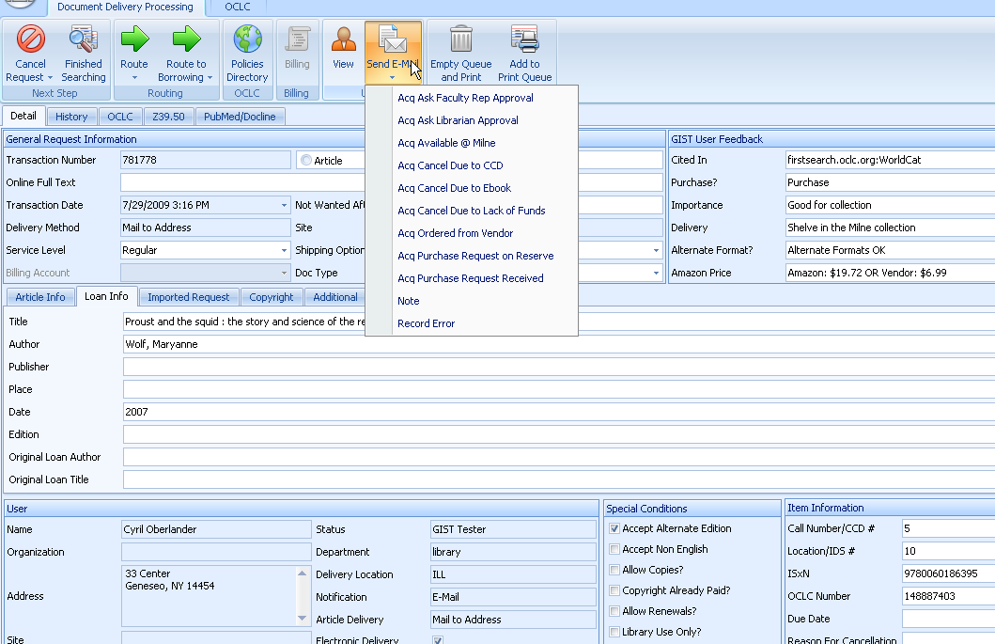
ILL & GIST Workflow Screenshots
Notes:
How easy it is to send emails to users, department reps, librarians, etc., or route a request to a specific status, or even from Acq. To ILL.

Slide 19
So WHY?

Slide 20
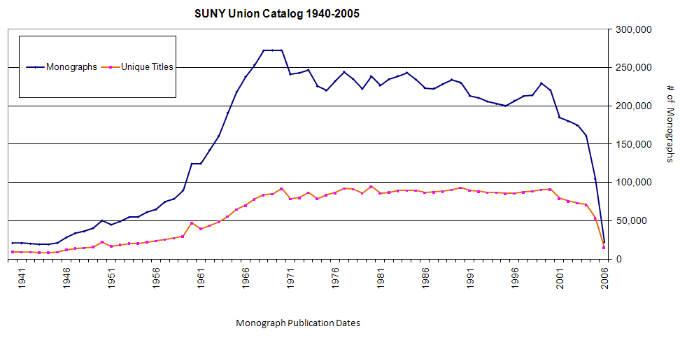
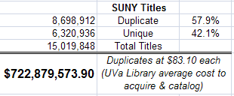
SUNY Union Catalog – Rough Uniqueness Estimates…
Cost of Duplication
As of 12/18/08 over $722 Million
Interlibrary Loan Matures
How much duplication is critical?
Can we afford Just in Case?
Notes:
What price duplication? CLICK
This is an extremely rough estimate of the price of duplication of the SUNY Collection; if even half of this figure approximates the actual cost of duplication is significant. Add to this the cost of collection maintenance, including the cost of weeding duplication – which is an ongoing activity at most libraries, typically selecting duplicated items, all of this adds to the following figure; However, CLICK
We have to understand the context changed recently; the importance of local collections was significantly reduced as Interlibrary Loan systems began to really mature, initially with OCLC, RLIN, and WLN, and later with robust request systems like ILLiad, and consortia borrowing systems. Mature ILL systems have made consortia borrowing an effective strategy for sharing resources among faculty and students at large.
Note: 35 SUNY Collection titles per student

Slide 21
April 6, 2008 a day in the life of ILL…
110 borrowing requests for loans came into SUNY Geneseo, of these…
79.1% or 87 items could be purchase from Amazon; about 46% could be purchased for under the ARL unit cost for borrowing: $17.50
Over 1/3 could be purchased for less than $10 used
(almost 1/5 for less than $5)
Over 1/5 could be purchased new for less than $10.
When should we evaluate buying options?
& when NOT?
Notes:
First, consider what I found searching 110 ILL book requests from one day last spring. Highlight screen findings
Explain that the reality of weeding for 10-20 years will have a significant impact on the used book market, and possible strategies.

Slide 22
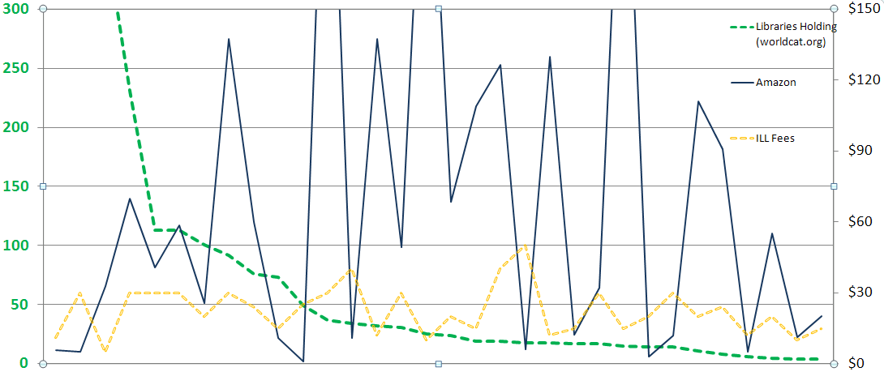
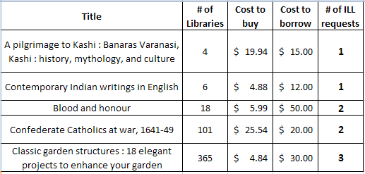
Strategies – Cost, Uniqueness, Use
Why Purchase on Demand / Just in Time Acquisition…
One study of Purchase on Demand books found that within 5 months:
28.7% ILL Purchase on Demand books checked out again.
18% Regular Acquisition books were checked out once.
Ward, 2002
Notes:
From an ILL borrowing perspective, purchasing strategies can make a lot of sense. This graph is a look at Geneseo’s borrowing when we requested materials not held by SUNY and IDS libraries, and there were lending charges incurred for the request. The opportunity cost between borrow and buy, plus the collection diversification are key values useful for both ILL and collection development processes.
CLICK – here are some of the titles from the graphed sample. Opportunity cost is a great strategy, however, it is best at the point of need.
CLICK – Lastly, if use is a measure of success in collection building, then Just in Time Acquisition has been shown to lead to subsequent use. How does that compare to many libraries selecting just in case that are fortunate if 50% of their new titles are ever checked out.

Slide 23
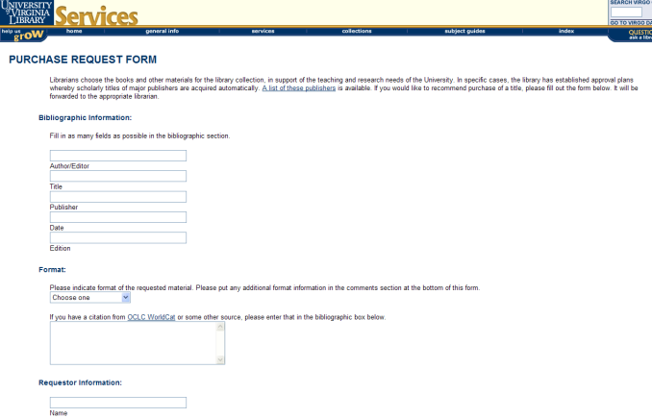
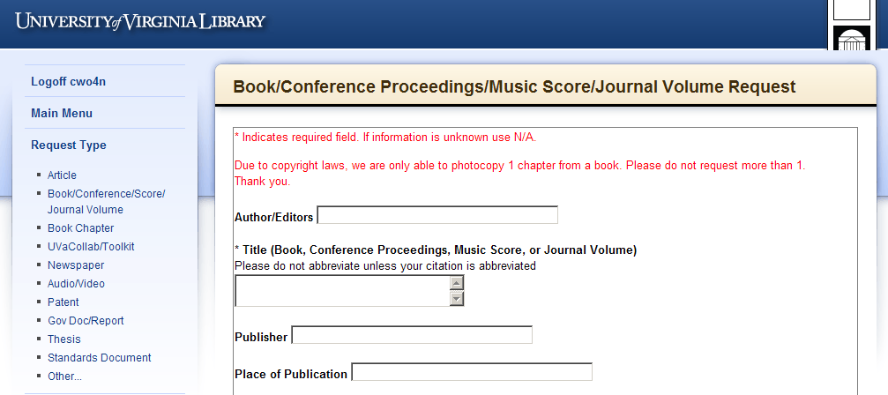
Getting It System Toolkit (GIST): http://idsproject.org/Tools/GIST.aspx
Focuses on enhancing Acquisition, Collection Development & ILL workflow
Purchase Request
Interlibrary Services Request
Strategy?
Email from php website
Requests managed with;
  automation,
  links to Worldcat,
  email system (custom & canned),
  transparent process to user.
Staff mediated process
Black box process for user
OR
Notes:
The Getting It System Toolkit (GIST) is a set of tools being developed by a team at SUNY Geneseo and some programming consultants, the project is funded many thanks to RRLC.
GIST will provide libraries with a set of customizable templates and tools that enhance and ideally, transform acquisition, collection development and ILL workflows.
Why - Library Services are fragmented by Request Systems that Reinforce functional divisions, take purchase request forms and ILL forms as an example…
CD Librarian get an email from their web form, Library Clerk looks up prices in Amazon or Gobi, looks up holdings in SUNY Catalog, looks up department budget, Decision tree may require a bibliographer or subject selector, or liaison review, and a few conversations, then it becomes an approved selection, which could mean handing it off to an acquisitions and/or cataloging person, and so on. The user is meanwhile in the dark about the status of this request, and what communication there is, is often made from someone’s email, rather than a system generated email that eliminates rekeying information.
On the other hand, ILL which had a similar website email system 10 years ago, now has a system that manages user requests and enables automated processes that free staff time and enables customizing and adding value to the service.
Transforming traditional ILL and collection development workflow depends on the local strategies that make sense.

Slide 24
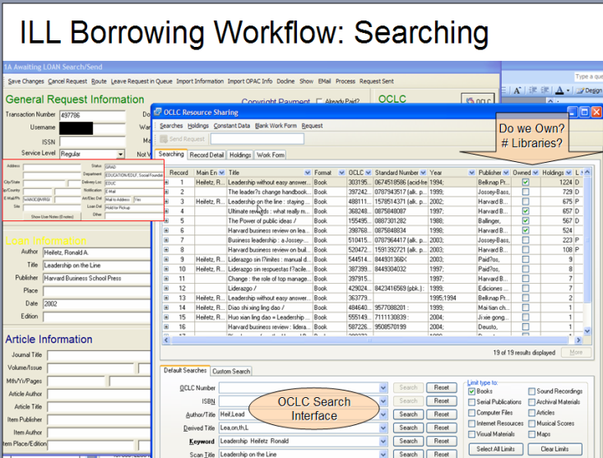
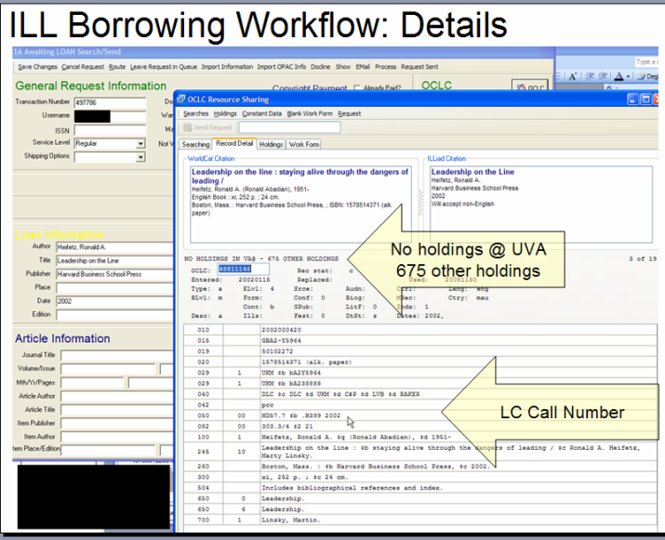
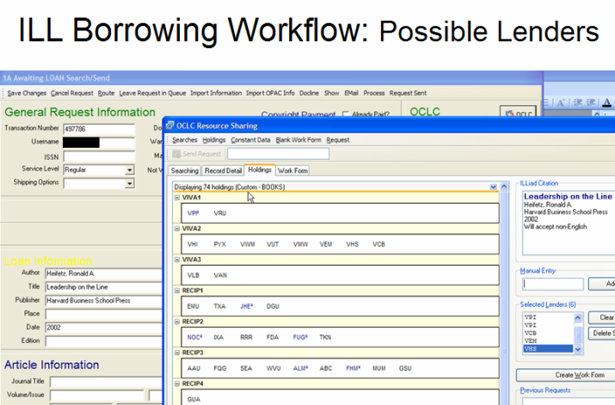
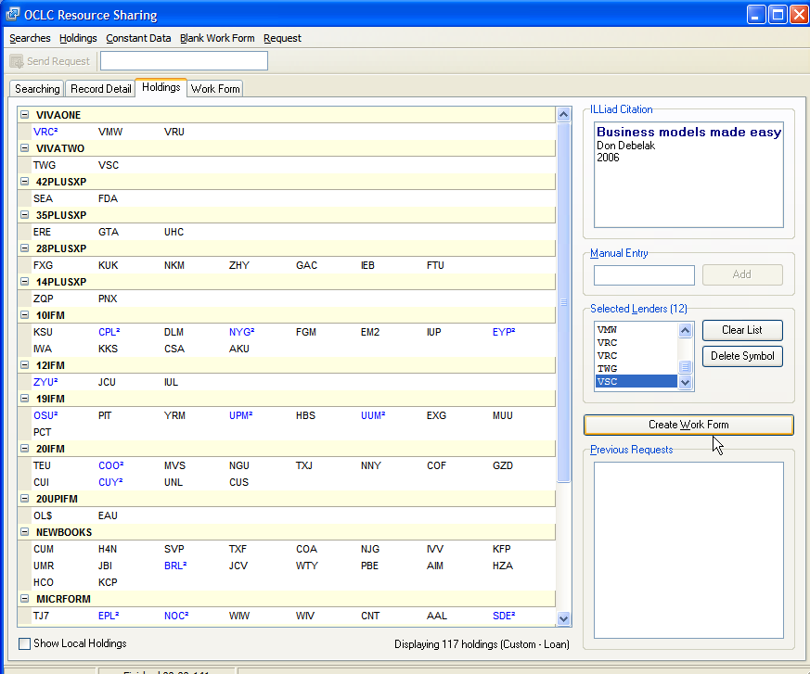
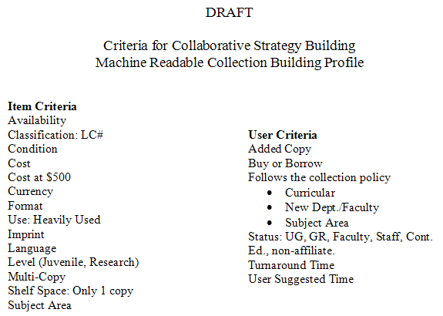
Getting It System Toolkit – conceptual framework
$
Proposed Services…
User Recommendations
Amazon$ like worldcat.org
Just in Time Acquisition:
  Buy for Library,
  Attach OCLC symbol, &/or download to ILS
Refer to selector for review.
Buy for user
Rent for user
APIs to Google Book, Amazon, CCC, OCA, Publishers, etc.
Edit OCLC holdings
Notes:
This is a conceptual framework of GIST that looks at transforming and combining various processes to streamline our work. Requests undergo a series of decisions that are made easier because web services bring in data at the point of request and handling.
Illustrate.

Slide 25

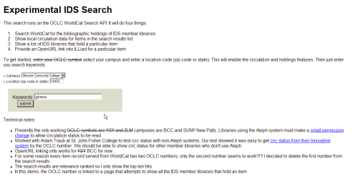
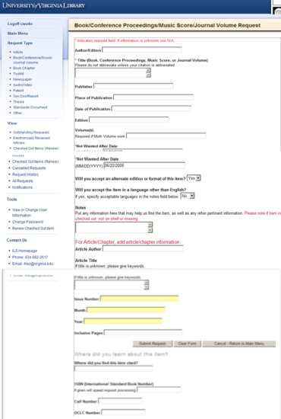

GIST ver. 2 (target: Aug. 2010)
@ point of Discovery…
Version 2 Features
Budget Management: Grant, individual, and department budgets can be shown and selected i.e.: This item costs $45.43; your department book budget is $567, do you want to continue with this order? Includes budget and account transaction tracking, review & approvals systems.
Other Data: Book Burro, IDS Project Data, Copyright Clearance, book jobbers, OCLC Holdings & record download to ILS.
Gift Management Processing: Automate gift selection and acknowledgement processing with collection building profile services.
ILLiad web request forms
ILLiad Client workflow
(with extra data pulled in)
Hybrid workflow
Custom queues
Custom email routings & text files
Purchase on Demand & Purchasing workflow
Notes:
Looking at the long of it… by August 2010
GIST Version 2 goals include a set of budget management features that allows users and approvers tracking of their budgets, other services, such as attaching OCLC symbols, and a set of gift management tools that automate gift selection within collection building targets, provides automated donor letters with lists of items, and slices and dices…

Slide 26
What about Group Purchase on Demand Strategies for Libraries?
IDS Project 2006/2007 Data: Filled by non-IDS Project Libraries…
Articles Subscription Cost
79 requests for Early Child development and Care $2,973
57 requests for Terrorism and Political Violence $610
51 requests for Archives of general psychiatry $490
Loans New Cost
15 requests for Synthesis and optimization of digital circuits $135.69
7 requests for Treatise on harmony $10.10
6 requests for The pursuit of happiness $3.24
What data and criteria matter for cooperation? TPAM2?
How do we get that data to where it is needed - workflows?
Notes:
If we look beyond the request by request and local view, how does the data help collectively? This data is an excerpt from Project IDS data, looking specifically at frequent requests filled outside the group of libraries. Often, these are requests filled with some lender feeds.
Obviously with groups or networks of libraries, it makes sense to begin asking the question, especially during these times, can we do more to leverage the shared value of what we are doing?
As library monograph budgets are reducing across the country, the cost of ILL is going to increase because the times you go outside your reciprocal (non-charging) groups will only increase with time. So…
How do we begin to use this data is the next question worth raising because it offers the value of diversifying our collections that are valued by user demands from our group.

Slide 27
Thank you
GIST Information: http://idsproject.org/Tools/GIST.aspx
GIST Feedback:
http://gettingitsystemtoolkit.blogspot.com
Cyril Oberlander, SUNY Geneseo
cyril@geneseo.edu

